Slide 1
Olist E-Commerce Analysis
Azure SQL + T-SQL Database Analysis
Michael Amaya | Vanessa Quiroz | Jan Zika

Slide 2
Overview
About the Dataset
Goal
Brazilian e-commerce marketplace, data collected January 2017 – August 2018
11 tables | ~1.56 million rows
Orders, customers, sellers, products, payments, reviews, marketing leads
Analyze sales performance and customer behavior in a large e‑commerce marketplace
Jan: Sales & Revenue (Q01–Q04)
Michael: Customer & Delivery Behavior (Q05–Q08)
Vanessa: Seller & Product Performance (Q09–Q12)

Slide 3
Data Pipeline: SQLite → SQL Server
Source: single-file SQLite database (110 MB)
Python script:
Parsed the SQLite data
Generated SQL Server-compatible INSERT scripts for each entity
Handled type conversion, scientific notation, FK ordering, and data validation
Scripts executed in SQL Server Management Studio to create and populate the database on local SQL Server
Database exported as a .bacpac file and uploaded to Azure SQL for team access
SQL Server database schema verified via an SQL script
Verified data profile and types (sanity check)
Compared the result to an SQLite script ran on the original SQLite database

Slide 4
ER Diagram

Slide 5
Sales & Revenue
Jan Zika | Q1–Q4

Slide 6
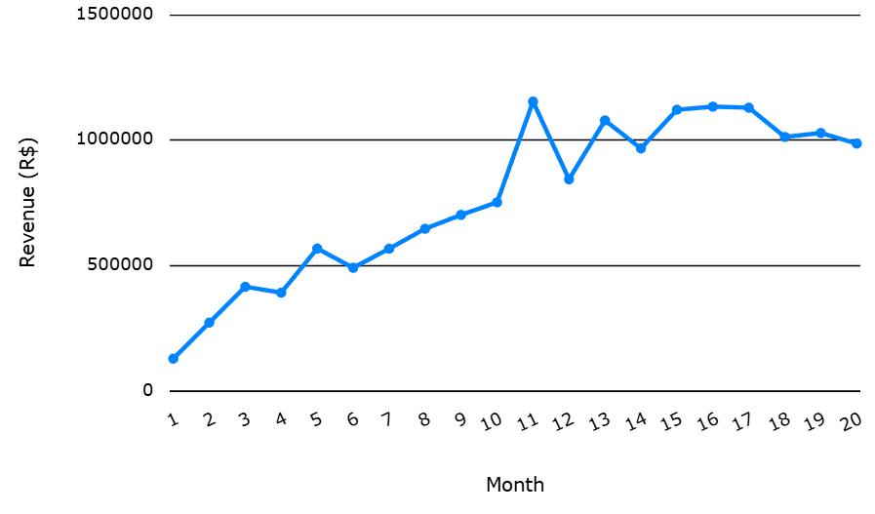
Revenue Trends
Q1 (+ View)
Revenue grew 9x from January 2017 to peak in November 2017 — potential seasonality (Black Friday effect)
Average monthly growth was 15%
Revenue plateaued in 2018 around R$1M

Slide 7
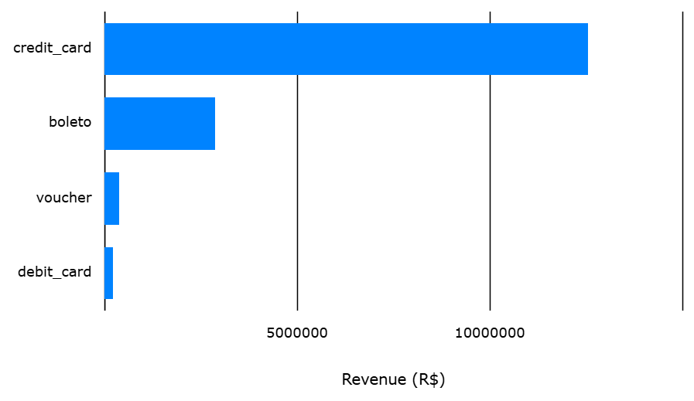
Payment Methods
Q2 (+ View)
Credit cards dominate — CC purchases split to 3.5 installments on average, confirms that installment culture is important in Brazilian e-commerce
Boleto (bank slip) second — no card required

Slide 8
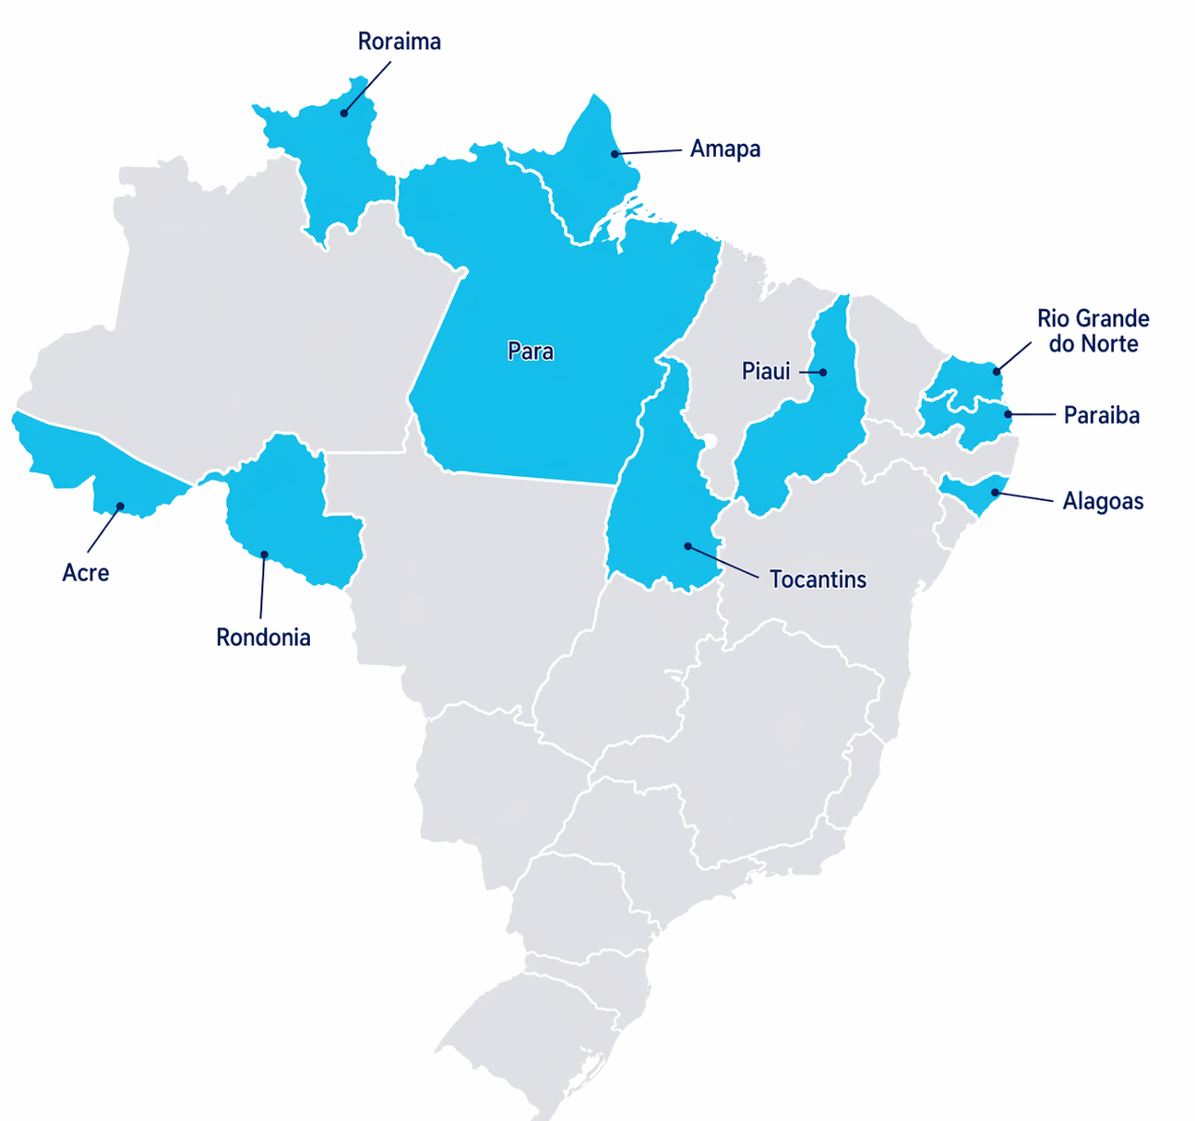
Order Value by State
Q3 (+ Stored Procedure)
Top 10 highest avg order value are all North/Northeast states
Paraíba highest: average product value R$192 + freight R$43 = R$235 total
Higher product values — not just freight inflation

Slide 9
Top 10 Categories by revenue
Q4
Health & beauty is #1 category by revenue: R$1.44M
Watches & gifts #2 Bed/bath/table #3 — lifestyle over electronics

Slide 10
Customer & Delivery Behavior
Michael Amaya | Q5–Q8

Slide 11
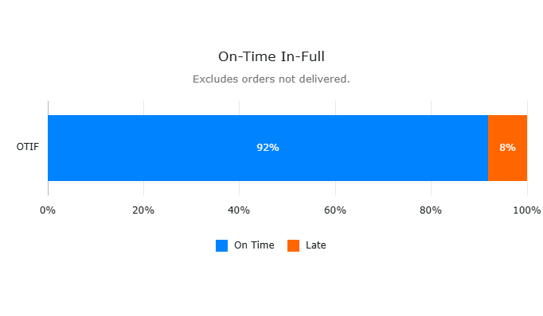
Delivery Time
Q5
91.88% On-Time Rate — High operational reliability.
1 in 12 Orders Late — 7,826 orders; significant service failure.

Slide 12
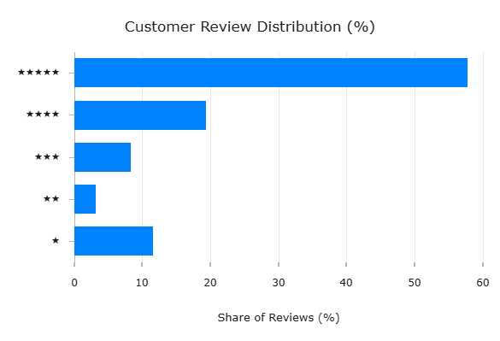
Customer Reviews
Q6
57.78% 5-Star Reviews — Majority customer satisfaction.
11.51% 1-Star Reviews — Critical failure rate.

Slide 13
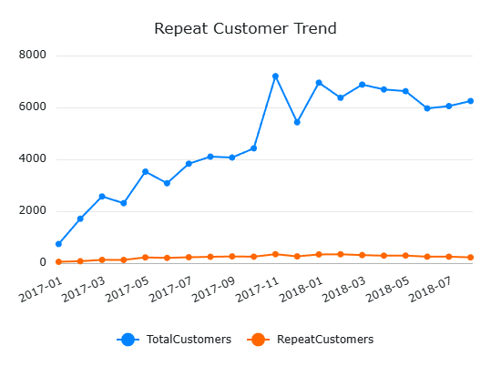
Order Insights
Q7
3% Retention Rate — High dependency on new customer acquisition.
2,840 Repeat Customers — Minimal loyalty out of a 95k customer base.

Slide 14
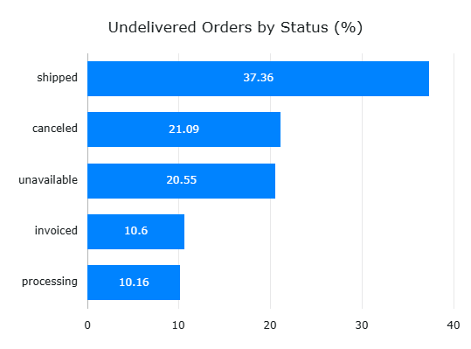
Order Insights
Q8
96,000+ Delivered — Successful large-scale distribution.
1,100 In-Flight — Active orders currently in processing or transit.
1,200 Lost Sales — Revenue lost to cancellations and inventory unavailability.

Slide 15
Seller & Product Performance
Vanessa Quiroz | Q9–Q12

Slide 16
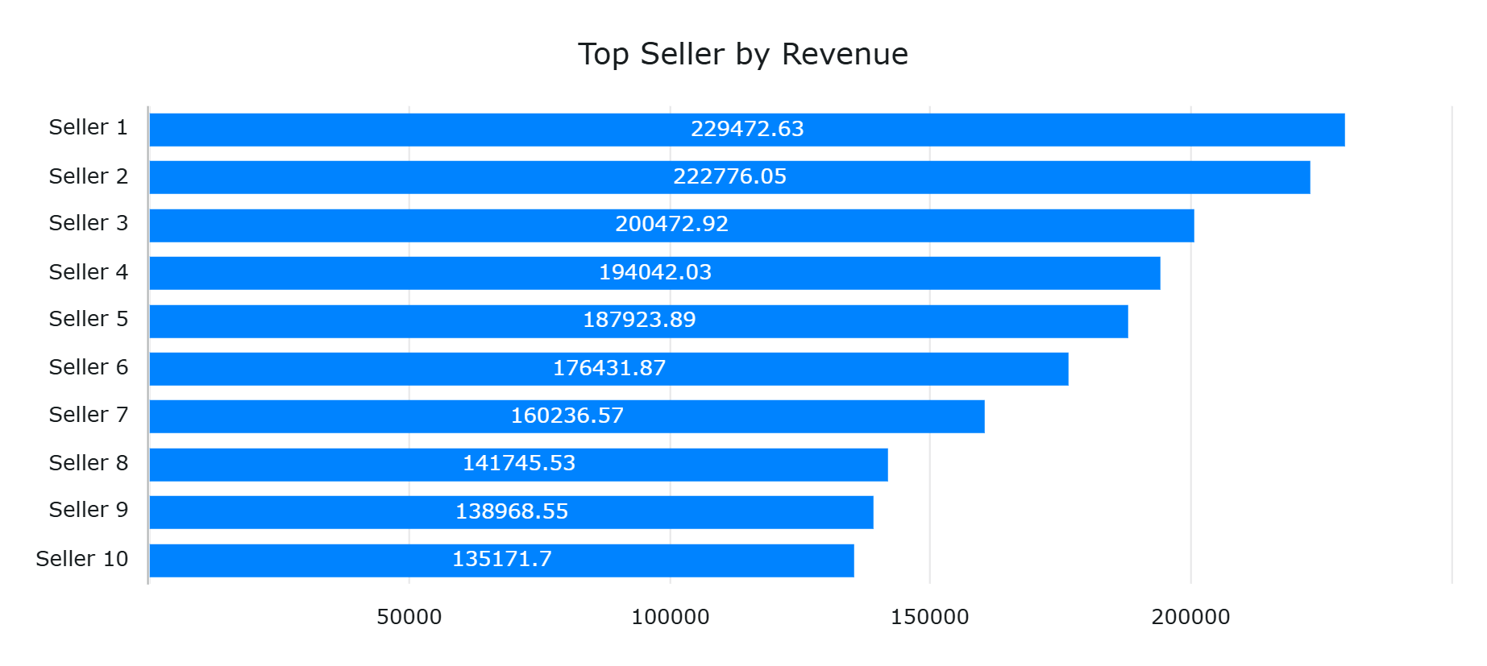
Top Sellers by Revenue: Performance and Order Volume Comparison
Key Insights:
Performance is not one-dimensional.
High volume - Lower Value sellers:
Seller #3 - 1,806 orders, avg value $111
Seller #7 - 1,314 orders, avg value $122
Low volume - Higher value Sellers:
Seller #2 - 358 orders, Avg value $622
Seller #6 - 336 orders, avg value $525
#1 seller is not the most efficient.
Highest total revenue=$229K
1,132 orders, avg value $203

Slide 17
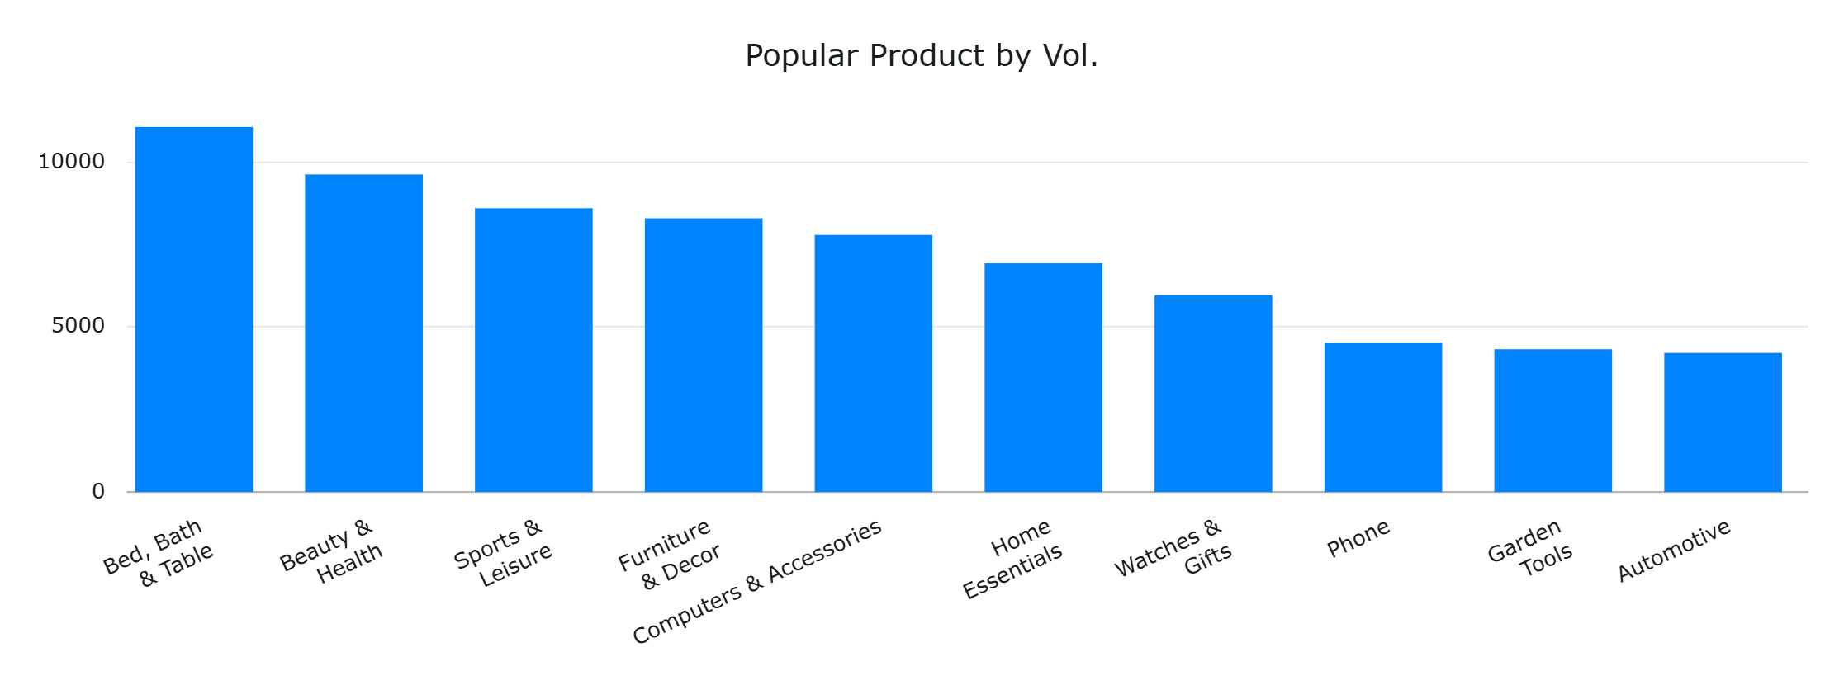
Most Popular Product Categories by Volume
Key Insights:
Home-related products dominate demand.
Demand is relatively concentrated at the top
* Category names were translated from Portuguese to English to improve clarity and interpretability.

Slide 18
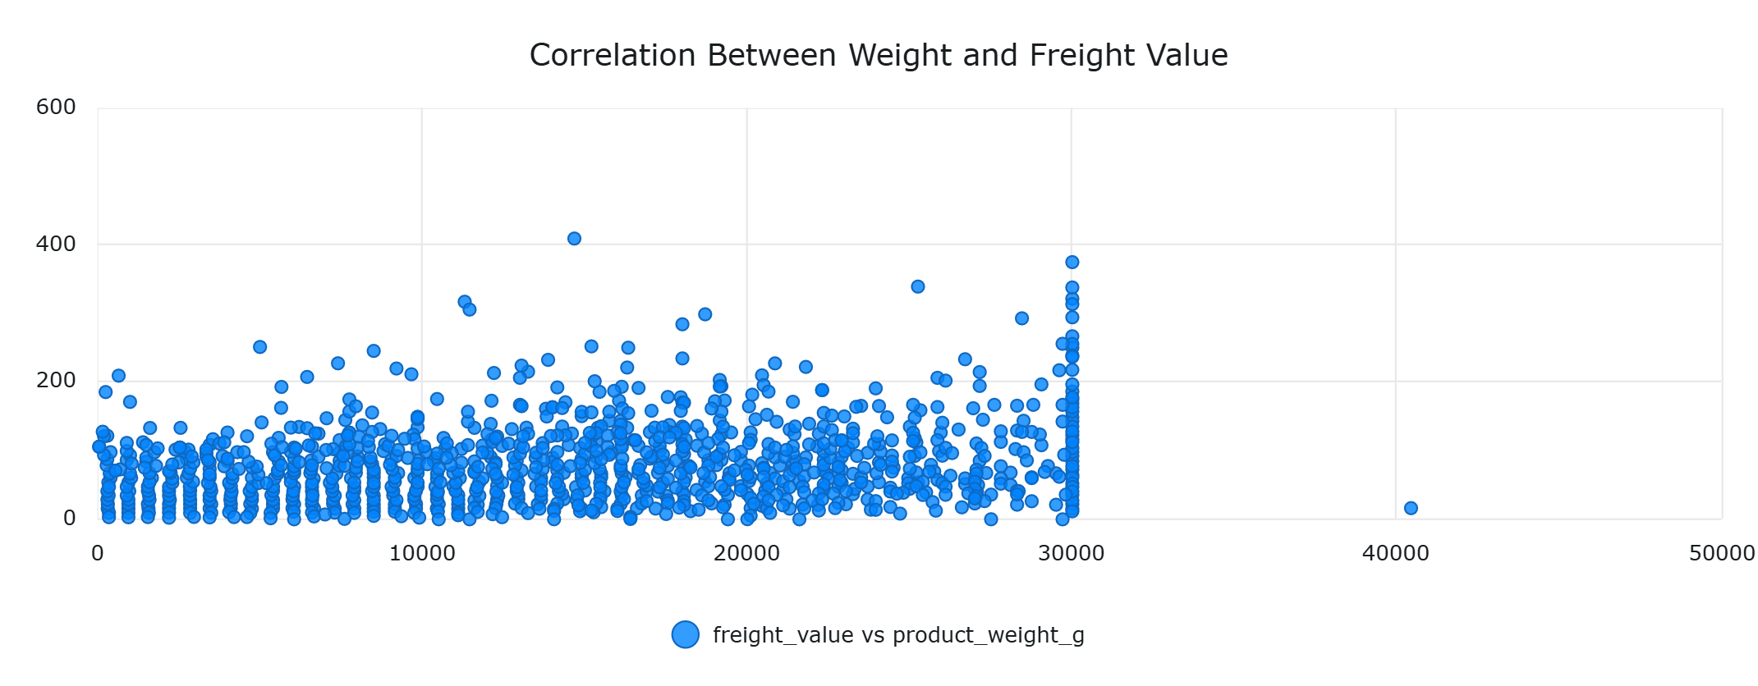
Relationship Between Product Weight and Freight Cost
Key Insights:
Weight influences cost, but it’s not the only driver.
Clustering suggests pricing constraints

Slide 19
Bonus: Geolocation
Jan Zika | View + Q13

Slide 20
The Geography of Brazilian E-Commerce
City Route | Order Count | Average Distance (miles) | Average Freight Cost (R$)
São Paulo → São Paulo | 6,895 | 11 | 10.26
São Paulo → Rio de Janeiro | 2,396 | 233 | 18.58
Ibitinga → São Paulo | 1,957 | 195 | 14.14
São Paulo → Belo Horizonte | 1,063 | 312 | 16.96
Ibitinga → Rio de Janeiro | 897 | 388 | 18.32
Santo André (SP) → São Paulo | 756 | 16 | 10.13
São José (SP) → São Paulo | 713 | 55 | 10.43
São Paulo → Goiânia | 641 | 505 | 15.71
São Paulo → Brasília | 609 | 544 | 17.33
São Paulo → Curitiba | 595 | 226 | 17.37
Sao Paulo is basically Amazon Brazil
One city shows up in 8 of the top 10 shipping routes.
The SP→SP route alone beats the next three routes combined.
Ibitinga who?
A town of 60,000 people
Brazil's #2 seller city. Zero name recognition, but shipping textiles/craft to the entire country. Specialization > size.
533 miles for R$ 7 (~ $1.40) extra
Shipping from Sao Paulo to Brasilia costs about the same as shipping across town.
Distance barely moves the needle on freight
Rio de Janeiro
All vibes, no warehouses
RJ is a top destination on two routes but nowhere to be found as a seller. The city buys. It does not ship.

Slide 21
Interactive MAP
https://olist-db.netlify.app/

Slide 22
References
Dataset: https://www.kaggle.com/datasets/terencicp/e-commerce-dataset-by-olist-as-an-sqlite-database
Project Repo: https://github.com/jan-zika/olist-db
Database: Azure SQL
Tools: SSMS, Azure SQL, Python, DBCode, dbdiagram.io

Slide 23
Questions?

